Slide 1
Obstacle Avoiding Robot
ibrahim: 2451-17-737-022
vaseem: 2451-17-737-023
Under the Guidance of
D. B. V. Ravi Sankar sir
Designation: associate professor

Slide 2
What Is “Robotics”?
The word robotics is used to collectively define a field in engineering that covers the mimicking of various human characteristics.
It must be able to perform certain tasks we set for it.
The desired task must be achieved within some given limitations. It may be human controlled or automatic.

Slide 3
Why Robotics?
Mobile robots perform various ways of tasks to serve humans
No human guidance is required
This sort of project is very much useful in the industries where the automated supervision is required

Slide 4
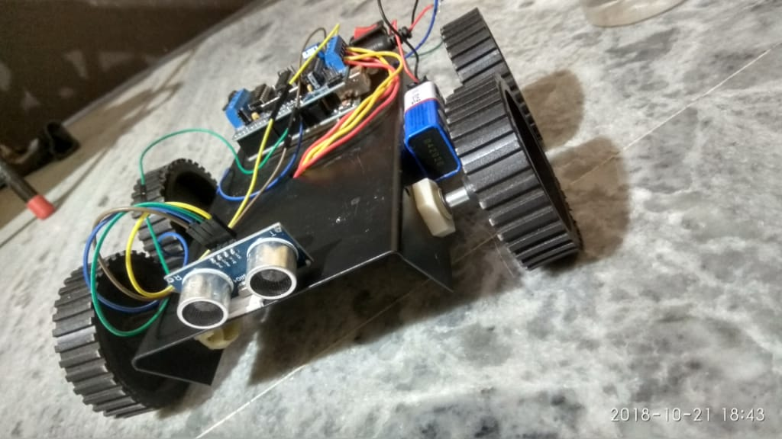
A Basic Structure Of Obstacle Avoidance Robot

Slide 5
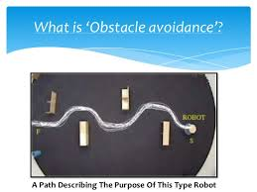
What is ‘Obstacle avoidance’?

Slide 6
abstract
The project is design to build an obstacle avoidance robotic vehicle using ultrasonic sensors for its movement. A micro-controller is used to achieve the desired operation.
The project proposes robotic vehicle that has an intelligence built in it such that it directs itself whenever an obstacle comes in its path.
This robotic vehicle is built, using a micro-controller. An ultrasonic sensor is used to detect any obstacle ahead of it and sends a command to the microcontroller.
Depending on the input signal received, the micro-controller redirects the robot to move in an alternate direction by actuating the motors which are interfaced to it through a motor driver.

Slide 7
Statement of problem
In this project our robot senses any obstacle in its path, avoids it and resumes its running
Involves the pre-computation of an obstacle-free path which a controller guides the robot

Slide 8
COMPONENTS
Arduino Board
Motor Shield L293D
Ultrasonic Sensor
DC Motor and Wheel x4
Chassis 4WD
Battery
Wires
Button

Slide 9
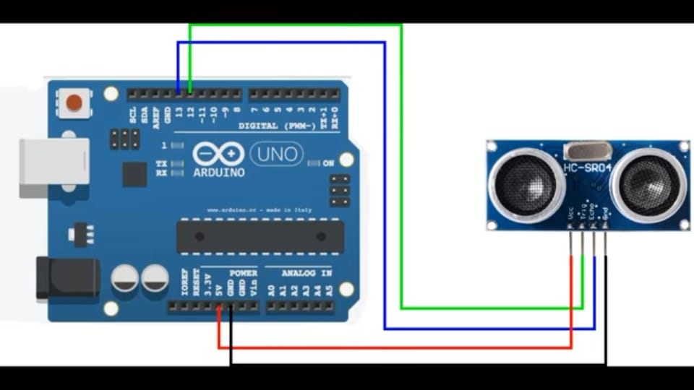
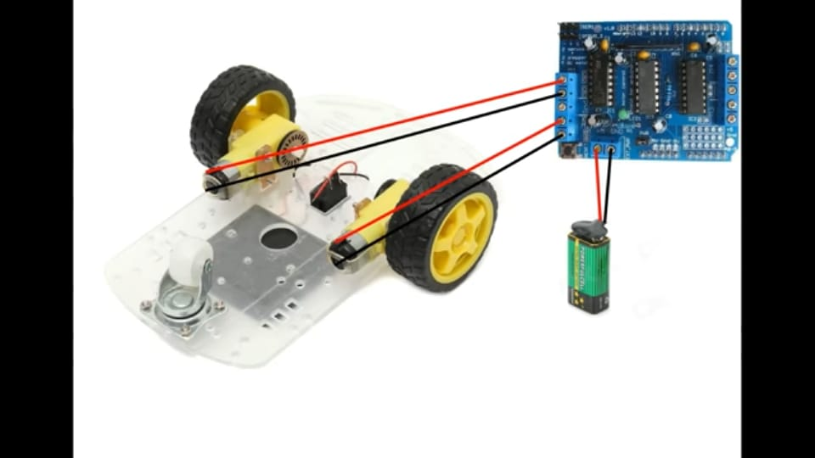
Circuit Diagram

Slide 10
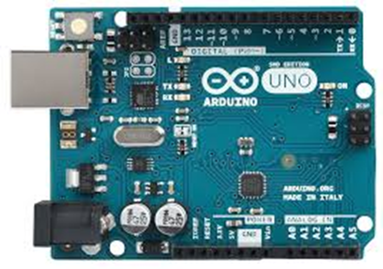
Arduino Uno
The Arduino UNO is an open-source microcontroller board
The board is equipped with sets of digital and analog input/output (I/O) pins that
may be interfaced to various expansion boards (shields) and other circuits.
The board has 14 Digital pins, 6 Analog pins, and programmable with the
Arduino IDE (Integrated Development Environment) via a type B USB cable.

Slide 11
ultrasonic Sensor
This sensor is a very popular sensor used in many applications where measuring distance or sensing objects are required.
The module has two eyes like projects in the front which forms the Ultrasonic transmitter and Receiver. The sensor works with the simple high school formula that
Distance = Speed × Time
The Ultrasonic transmitter transmits sound wave, this wave travels in air and when it gets objected by any material it gets reflected back toward the sensor this reflected wave is observed by the Ultrasonic receiver module as shown in the picture below

Slide 12
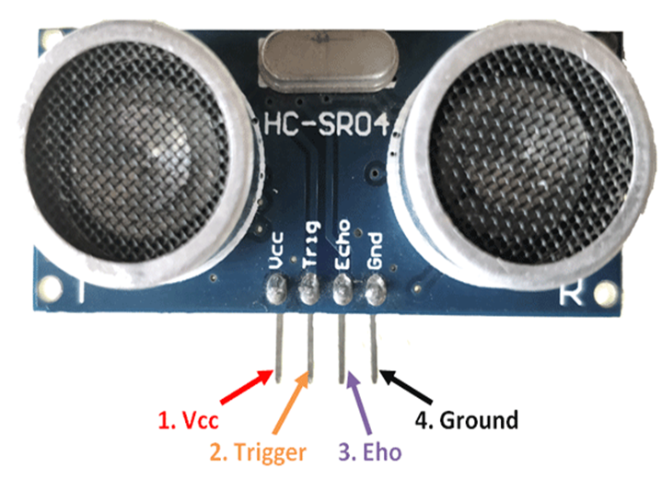
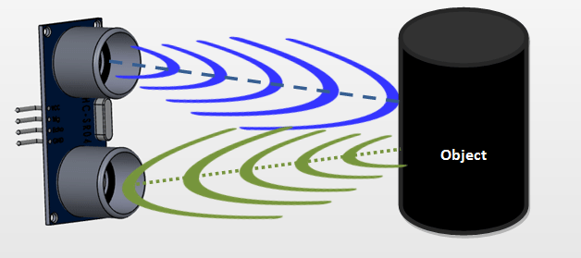
ultrasonic Sensor

Slide 13
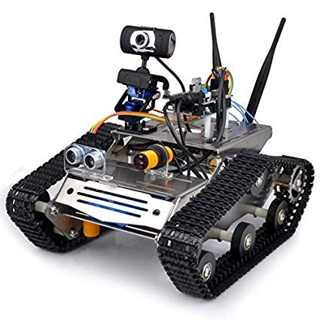
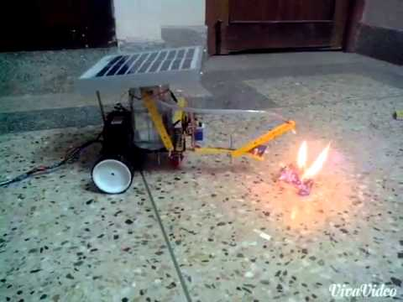
FURTHER IMPROVEMENTS & FUTURE SCOPE
Adding a camera
Use as a fire fighting robot

Slide 14
Software specification
We have implemented program using AFMotor and new ping libraries.
We have used basic C language in our program.
We have used Arduino IDE software for compiling and uploading the code.

Slide 15
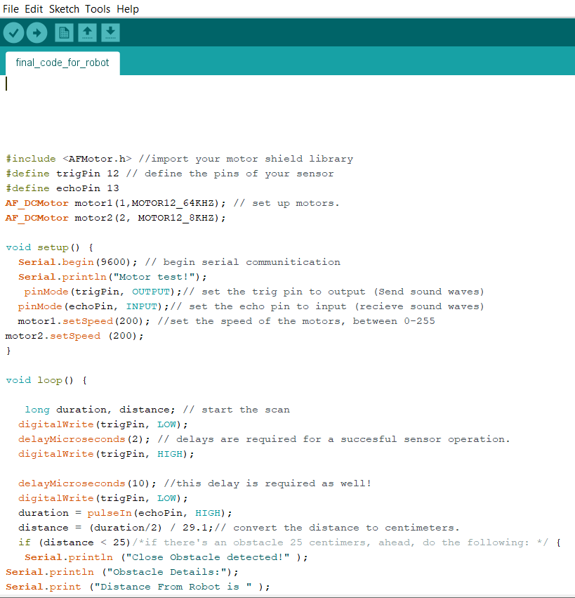
Screenshot of program

Slide 16
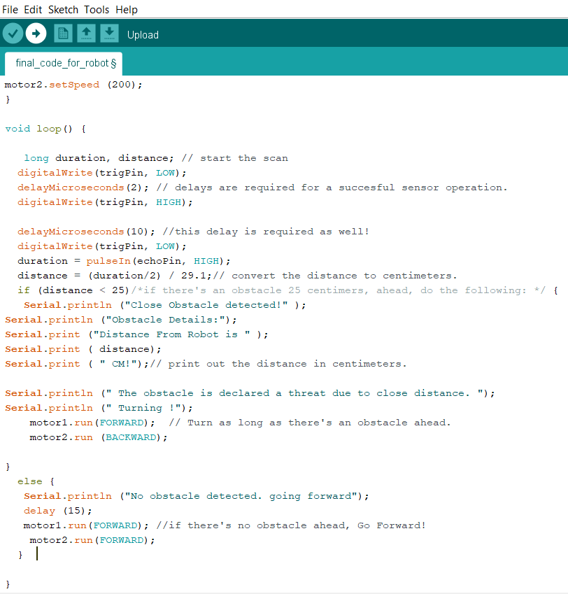

Slide 17
applications
1.They can be used as services robots, for the purpose of household work and so many other indoor applications.
2.Obstacle seeing robot can be applied at toys where small children will play.
3.It can be used for army applications.
4.Can be used in dangerous environments, where human penetration could be fatal.
5.Used in mobile robot navigation system.

Slide 18
reference
[1] Obstacle avoidance robotic vehicle using ultrasonic sensors for obstacle detection:http://www.elprocus.com/obstacle-avoidancerobotic-vehicle/
[2] How to make an obstacle avoiding robot: http://www.instructables.com/id/How-To-Make-anObstacle-Avoiding-Arduino-Robot/
[3] IEEE paper for Obstacle avoidance robot using ultrasonic sensors: https://ieeexplore.ieee.org/document/2085
[4] Obstacle avoiding robot without microcontroller: http://www.roboticsbible.com/project-obstacleavoiding-robot.html

Slide 19
conclusion
We build a robotic vehicle which moves in different directions like Forward, Backward and right when input is given to it.
The goal of our project is to create an autonomous robot which intelligently detects the obstacle in his path and navigate according to the actions that we set for it.

Slide 20
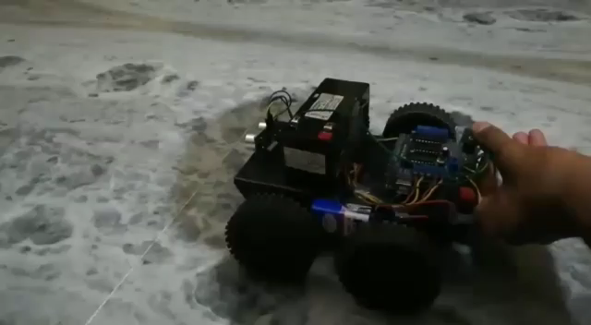

Slide 21
Thank you ☺
Any queries…..??

